Slide 1

Interconnection Networks in Multiprocessor Systems
By: Wallun Chan
Course: CS 147
Text: Chapter 12, p. 528 - 539
Professor: Sin-Min Lee

Slide 2
Table of Contents
Introduction
Fixed Connections
  Examples of some fixed communication connection systems
  Clustered communication system
Reconfigurable communication connections
  Crossbar switch system
  Multistage interconnection networks (MIN)
    Generalized Clos network
    Example of the Benes network
    Example of the Omega network
    Example of the Baseline network
Routing on Multistage Interconnection Networks
  Example of a routing algorithm for Benes network
  Example of a routing algorithm for Omega network
Switching techniques
  Store-and-forward
  Circuit switching
  Virtual cut-through switching
  Wormhole routing

Slide 3
Introduction
What are interconnection networks and why are they important?
Processors in a parallel computer need to communicate in order to solve a problem. Therefore, there is a need for some kind of communication highway or interconnection network, i.e. the processors to be connected in some pattern.
Performance in multiprocessor systems are highly dependent on communication processes between processors and memory, I/O devices, and other processors. Therefore, choosing the right interconnection network is important for efficiency reasons.
Interconnection networks can be categorized according to criteria such as topology, routing strategies, and switching techniques.
  Topology is the pattern in which the individual processors are connected to other elements. The two main topologies are fixed and reconfigurable.
  Routing strategies are procedures used to set switches and plays a crucial role in the performance of multistage interconnection networks
  Switching techniques are ways that data packets are handled on their way from a source to a destination processor.

Slide 4
Fixed Interconnection Networks
Fixed connection systems are hard-wired in place and cannot change their configurations.
Although not as flexible as reconfigurable connection systems, they are sufficient for most parallel computing demands and are less costly.
Generally, fixed topologies are suited for problems with well predicted communication patterns.
Mainly used for message-passing architectures.
Some examples of fixed connections include: Ring,Tree,Mesh, Shared Bus
One fixed connection topology not discussed so far:
  Clustered fixed connection

Slide 5
Some Multiple Instruction Multiple Data (MIMD) Fixed Connections
M
M
M
P
...
P
P
P
P
P
Cluster bus
P
P
Global
memory
P
A) Shared bus
B) Ring
P
P
P
P
P
P
P
P
P
P
P
P
P
P
P
P
C) Tree
D) Mesh

Slide 6
Other MIMD Fixed Connections
BACK
P
P
P
P
P
P
P
P
P
P
P
P
P
P
P
P
P
P
P
P
P
P
P
P
E) Hypercube
F) Completely connected

Slide 7
Clustered 16-Processor Fixed Connection
Divided into 4 clusters.
4 processors per cluster connected by cluster bus.
P
P
P
P
P
P
P
P
P
P
P
2 processors in same cluster bus can communicate with each other without affecting other clusters; this maximizes data flow and minimizes delay.
Intercluster
gateway
Intercluster
gateway
Intercluster
gateway
Intercluster
gateway
Intercluster
gateway
Intercluster
gateway
Cluster bus
Cluster bus
Cluster bus
Cluster bus
Cluster bus
Cluster bus
P
P
P
P
P
P
P
P
P
P
P
Intercluster
communications
mechanism
Intercluster gateways allow transfers between clusters.
Intercluster
communications
mechanism
P
P
P
P
P
P
P
P
The intercluster communications mechanism communicates between clusters; this may be a fixed or reconfigurable network.
Intercluster
gateway
Intercluster
gateway
Intercluster
gateway
Intercluster
gateway
Intercluster
gateway
Intercluster
gateway
Cluster bus
Cluster bus
Cluster bus
Cluster bus
If a task requires processors in more than one cluster, the following process occurs.
P
P
P
P
P
P
P
P

Slide 8
Cluster to Cluster Communication in 16-processor Fixed Connection
A processor in one cluster sends data and destination information to its intercluster gateway via its cluster bus.
P
P
P
P
P
Intercluster
gateway
Intercluster
gateway
Intercluster
gateway
The gateway evaluates the destination information to find its cluster.
Cluster bus
Cluster bus
Cluster bus
P
P
P
P
The data is then sent to the specified cluster through the communications mechanism.
Intercluster
communications
mechanism
Intercluster
communications
mechanism
P
P
P
P
Finally, the destination gateway sends the data to the destination processor.
Intercluster
gateway
Intercluster
gateway
Intercluster
gateway
Cluster bus
Cluster bus
Cluster bus
The processors never talk to each other directly; processors are free while gateways send the data.
P
P
P
P
P

Slide 9
Reconfigurable Connections
When different tasks require different processing resources, reconfigurable connections are needed.
Reconfigurable connections allow for dynamic configurations to match individual tasks thereby optimizing overall system performance.
Several reconfigurable connection configurations exist
  Crossbar switch connections
  Multistage interconnection networks (MINs)

Slide 10
Crossbar Switch Connections
Has n inputs and m outputs; n and m are usually the same.
0
1
Data can flow in either directions.
inputs
.
.
Each crosspoint can open or close to realize a connection.
.
.
.
.
All possible combinations can be realized.
n - 1
The inputs are usually connected to processors and outputs connected to memory, I/O, or other processors.
0
1
...
m - 1
outputs
These switches have complexities of O(n²); doubling the number of inputs and outputs also doubles the size of the switch.
To solve this problem, multistage interconnection networks were developed.

Slide 11
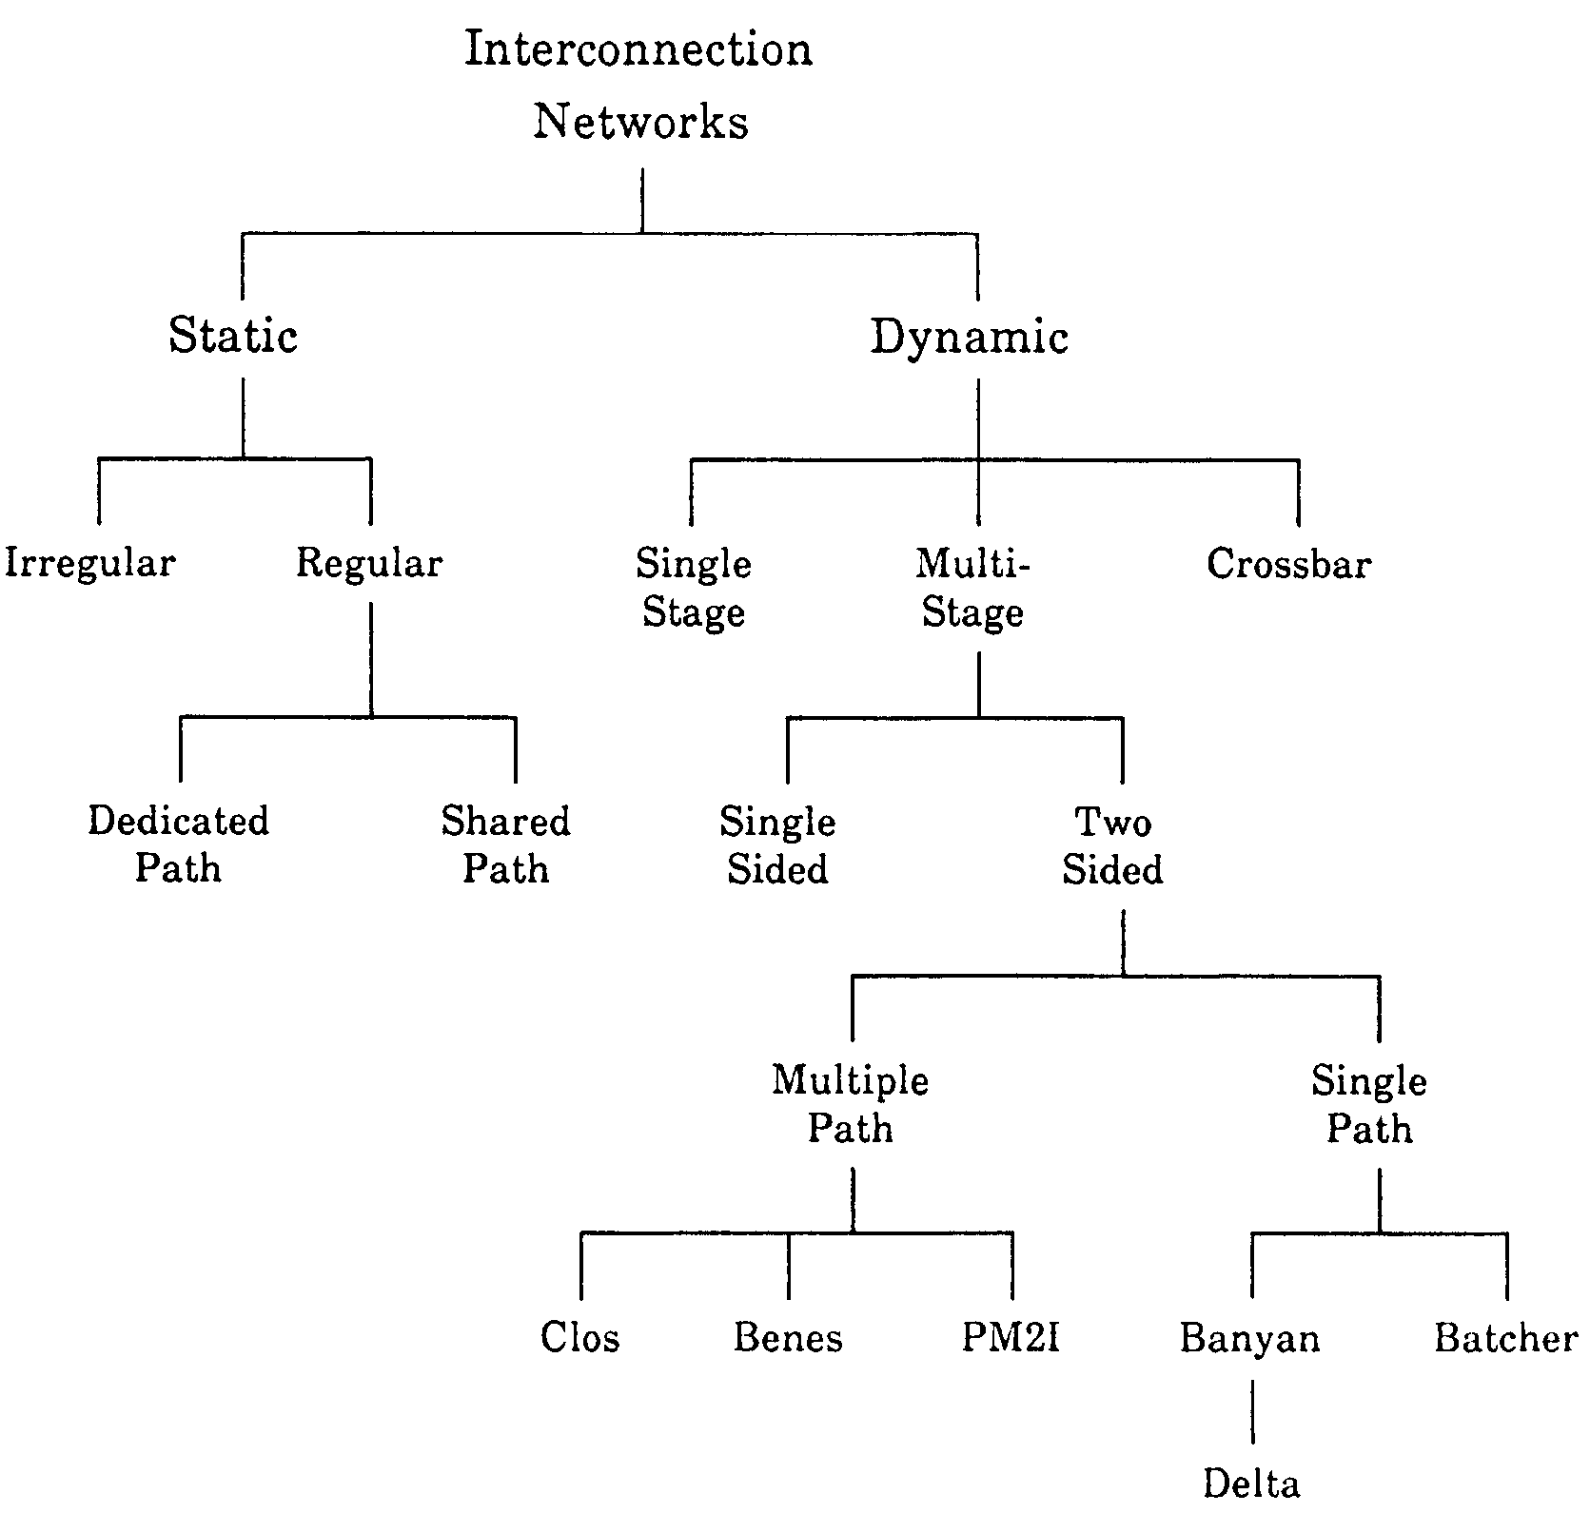
A Simple Classification of Interconnect Network

Slide 12
Multistage Interconnection Networks
Use smaller crossbar switches, usually 2 x 2, connected by fixed links.
These 2 x 2 switches have 2 possible settings for permutation networks, straight and exchange, as shown in figures below.
Inputs and outputs are connected in a 1 to 1 manner.
Multistage interconnection networks realize desired permutation networks of their inputs and outputs by setting the switches to the correct states.
Routing algorithms are used to set the switches of a multistage interconnection network.
0
0
0
0
1
1
1
1
Straight
Exchange

Slide 13
Banyan Network
Defined as having one and only one path from any input to any output and thus covers a very large class of possible network structure
A multi-stage network of interconnected crossbar switching elements originally defined in graph theoretical terms.
  Omega network was first multistage interconnection network followed by similar networks

Slide 14
Permutation Networks
Most multistage interconnection networks are designed to realize permutation networks, that is, networks with 1 to 1 connections between their inputs and outputs.
Multistage interconnection networks are classified into 2 groups.
  Nonblocking - can realize any of the n! connections between its n inputs and n outputs.
    Strictly nonblocking - can change a connection without affecting any other connections.
    Rearrangeably nonblocking - can realize new connections but may have to reroute existing connections.
  Blocking - cannot realize every possible combination between its inputs and outputs.
Some widely used multistage interconnection networks include
  Clos network
  Benes network
  Omega network
  Baseline network

Slide 15
Generalized Clos Network
NEXT
3 stages of switches with T = n * k inputs and outputs.
inputs
outputs
1st stage has k switches of size n by m.
0
0 0
1 1
0
n - 1 m - 1
0
0 0
1 1
0
n - 1 m - 1
0 0
1 1
0
k - 1 k - 1
0 0
1 1
0
k - 1 k - 1
0 0
1 1
0
m - 1 n - 1
1
0 0
1 1
0
m - 1 n - 1
1
.
.
.
.
.
.
.
.
.
.
.
.
.
.
.
.
.
.
.
.
.
.
.
.
.
.
.
.
.
.
.
.
.
.
.
.
2nd stage has m k by k switches that receive 1 input from each 1st stage switch.
n - 1
n - 1
3rd stage has k m by n switches that receive 1 input from each 2nd stage switch.
n
0 0
1 1
1
n - 1 m - 1
n
0 0
1 1
1
n - 1 m - 1
0 0
1 1
1
k - 1 k - 1
0 0
1 1
1
k - 1 k - 1
0 0
1 1
1
m - 1 n - 1
n + 1
0 0
1 1
1
m - 1 n - 1
n + 1
.
.
.
.
.
.
.
.
.
.
.
.
.
.
.
.
.
.
.
.
.
.
.
.
.
.
.
.
.
.
.
.
.
.
.
.
2n + 1
2n + 1
If m ≥ n, network is rearrangeably nonblocking.
.
.
.
.
.
.
.
.
.
If m ≥ 2n-1, network is strictly nonblocking.
T - n
T - n
0 0
1 1
k - 1
n - 1 m - 1
0 0
1 1
k - 1
n - 1 m - 1
0 0
1 1
m - 1
k - 1 k - 1
0 0
1 1
m - 1
k - 1 k - 1
0 0
1 1
k - 1
m - 1 n - 1
T - n + 1
0 0
1 1
k - 1
m - 1 n - 1
T - n + 1
.
.
.
.
.
.
.
.
.
.
.
.
.
.
.
.
.
.
.
.
.
.
.
.
.
.
.
.
.
.
.
.
.
n, m, and k can be changed to realize complexities between O(n lg n) to O(n²).
.
.
.
T - 1
T - 1

Slide 16
Benes Network
Derived from Clos network by setting n = m = 2, and k = T / 2, and recursively decomposing the two center (T / 2) x (T / 2) switches.
BACK
For example, to create an 8 x 8 Benes network, four 2 x 2 switches in the 1st and last stages are created.
0
0
1
1
Two 4 x 4 switches in center stage.
2
2
1 output of each 1st stage switch routed to an input of each center stage switch.
3
3
1 input of each last stage switch routed from an output of each center stage switch.
4
4
5
5
The center stage switches are further decomposed into 2 x 2 Benes networks.
6
6
7
7
Is rearrangeably blocking and has complexity of O(n lg n).

Slide 17
8 x 8 Omega Network
Maximum of log28= 3 passes are needed for 8 input omega network
Consists of four 2 x 2 switches per stage.
The fixed links between every pair of stages are identical.
0
A
0
A
E
E
I
I
1
1
A perfect shuffle is formed for the fixed links between every pair of stages.
2
2
B
F
B
F
J
J
3
3
Has complexity of O(n lg n).
4
C
G
4
C
G
K
K
For 8 possible inputs, there are a total of 8! = 40,320 1 to 1 mappings of the inputs onto the outputs. But only 12 switches for a total of 2¹² = 4096 settings. Thus, network is blocking.
5
5
6
D
6
D
H
H
L
L
7
7
Possible permutation in single pass n n/2
(n! in all) 8 4 / 8! = 10.16% permutations out of all permutation implementable in first pass in 8 input omega network

Slide 18
Omega Network
Network Performance
  Scalability
    Ability of network to be modularly expanded with scalable performance with increasing machine resources
  Omega is more scalable than crossbar
    Cost complexity – O(nlog n) vs O(n 2)
    Latency complexity-O(log n)vs O(n 2)

Slide 19
Baseline Network
Similar to the Omega network, essentially the front half of a Benes network.
0
A
0
A
E
I
The figure to the right shows an 8 x 8 Baseline network.
1
1
To generalize into an n x n Baseline network, first create one stage of (n / 2) 2 x 2 switches.
2
C
2
C
G
J
3
3
Then one output from each 2 x 2 switch is connected to an input of each (n / 2) x (n / 2) switch.
4
B
4
B
F
K
5
5
Then the (n / 2) x (n / 2) switches are replaced by (n / 2) x (n / 2) Baseline networks constructed in the same way.
6
D
6
D
H
L
7
7
The Baseline and Omega networks are isomorphic with each other.

Slide 20
Isomorphism Between Baseline and Omega Networks (cont.)
Starting with the Baseline network.
If B and C, and F and G are repositioned while keeping the fixed links as the switches are moved.
0
0
A
E
I
1
1
2
C
2
B
F
G
J
J
The Baseline network transforms into the Omega network.
3
3
4
B
4
C
G
F
K
K
Therefore, the Baseline and Omega networks are isomorphic.
5
5
6
D
H
L
6
7
7

Slide 21
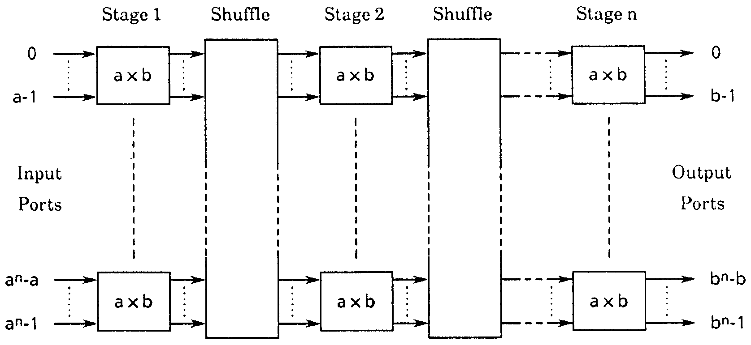
General Structure of Delta Network

Slide 22
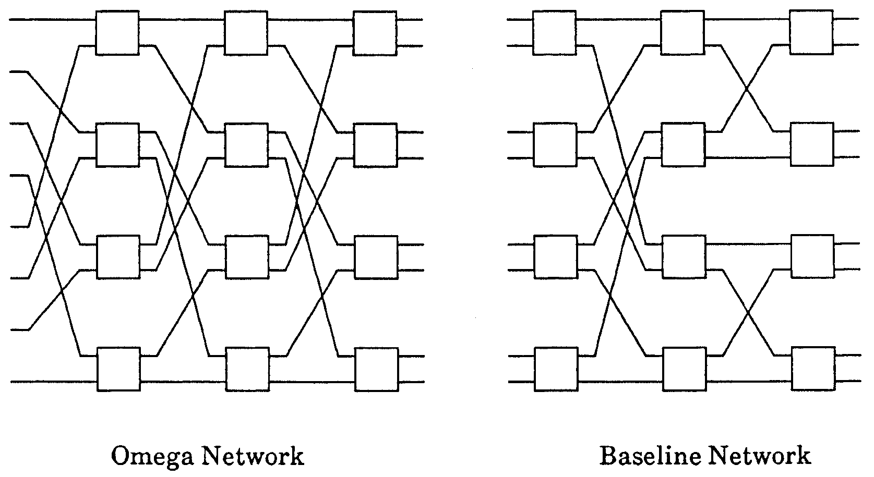
General Structure of Delta Network
Example : Omega Network, Baseline Network
Example :SW-banyan, Omega,flip network, indirect binary n-cube, baseline,reverse baseline networks which have all been proven to be topologically equivalent

Slide 23
Routing on Multistage Interconnection Networks
Routing algorithms play a crucial role in the performance of a multistage interconnection network. Slow routing algorithms will greatly reduce the performance of a multiprocessor system.
A multistage interconnection network can have many different routing algorithms from which to choose. But one is chosen and implemented into the system during its design.
But before examining routing algorithms for multistage interconnection networks, notations for permutations must be introduced.

Slide 24
Permutation Notation
A permutation is represented as a two-row matrix bounded by parentheses. The top row is the list of sources, and the bottom row is the list of destinations.
For example, the straight permutation of the switch below would be
represented as
01
01
.
01
10
The exchange permutation would be represented as
.
01
01
01
10
, .
The group realizable by this switch is
0
0
0
0
1
1
1
1
Straight
Exchange

Slide 25
Permutation Notation (cont.)
Settings of individual switches of a stage can be concatenated to form settings for entire stages.
0
0
1
1
For example, in the Benes network, assume the switches in the 1st stage are set to realize
2
2
3
3
0 1
0 1
2 3
3 2
4 5
5 4
6 7
6 7
,
,
,
.
4
4
5
5
The setting for the entire stage is the concatenation of these settings,
6
6
7
7
0 1 2 3 4 5 6 7
0 1 3 2 5 4 6 7
.

Slide 26
Permutation Notation (cont.)
To express the mapping realized by sequential permutations, the permutations are combined.
0
0
0
1
1
1
For example, assume the 1st stage switches are set to realize p(S₁) =
2
2
2
0 1 2 3 4 5 6 7
0 1 3 2 5 4 6 7
3
3
.
3
The links are fixed and always realize the mapping
4
4
4
5
5
0 1 2 3 4 5 6 7
0 4 1 5 2 6 3 7
5
.
So the result for the 2nd stage is p(S₁) x L₁ =
6
6
6
7
7
7
0 1 2 3 4 5 6 7
0 4 5 1 6 2 3 7
.
The permutation of a network can be expressed as the product of the stage and link permutations:
i-1
Π
p = (p(S_{j}) x L_{j}) x p(S_{i})
j=1

Slide 27
Routing Algorithm for Omega Network
Unlike the Benes network, which uses a centralized algorithm to set all of its switches, the Omega network uses a distributed, self routing procedure.
The switches examine the destinations of their input data and set themselves. No central routing hardware is needed.
Because of this, the switches in each stage can be set in parallel, and the network can be set up in O(lg n) time.

Slide 28
Routing Algorithm for Omega Network (cont.)
To understand this routing algorithm, consider the 1st stage of the Omega network to the right.
0
A
E
0
E
I
I
1
1
All four 1st stage switches send their upper outputs to switches E and G, and their lower outputs to switches F and H.
2
B
F
2
F
J
J
3
3
Switches E and G both send their outputs to switches I and J; their data can only reach the network outputs of 0, 1, 2, and 3.
4
C
G
4
G
K
K
5
5
Similarly, data from switches F and H can only reach network outputs 4, 5, 6, and 7.
6
D
H
6
H
L
L
7
7

Slide 29
Routing Algorithm for Omega Network (cont.)
Each 1st stage switch must be set so that its upper output has a destination with binary value 000, 001, 010, or 011, i.e. having 0 in the first bit position of its destination.
BLOCKED
(111)
(100)
0
A
E
I
0
(111)
1
1
Similarly, the lower output of each 1st stage switch must have a 1 in the first bit position of its destination to reach outputs 100, 101, 110, or 111.
2
B
F
J
2
3
3
4
C
G
K
4
For example, if network input 0 has to establish a connection with network output 7 (111), then the uppermost 1st stage switch must set itself to exchange.
5
5
6
D
H
L
6
7
7
If two inputs to a 1st stage switch have the same value in the first bit position, the Omega network cannot realize this permutation.
For example, if network input 0 has network output 4 and network input 1 has network output 7 as their destinations, then switch A is blocked since both 4 (100) and 7 (111) have bit 1 in their first bit position.

Slide 30
Routing Algorithm for Omega Network (cont.)
Similarly, the 2nd stage switch sends its upper output to switches I or K, which connect to outputs 0 (000), 1 (001), 4 (100), and 5 (101).
0
A
E
I
0
I
1
1
The lower outputs can reach switches J or L, which can access outputs 2, 3, 6, and 7 (010, 011,110, and 111).
2
B
F
J
2
J
3
3
For the second stage, the 2nd bit of the destination determines the setting of the switch.
4
C
G
K
4
K
5
5
Similarly, the least significant bit of the destination determines the setting of the switches in the 3rd stage.
6
D
H
L
6
L
Since the 3rd stage outputs are the outputs of the network, the last stage cannot block a permutation that has been routed successfully by the previous stages.
7
7

Slide 31
Successful Omega Routing Scheme
0
111
011
000
0
1
011
001
1
000
001
111
011
2
2
3
110
3
101
010
001
101
4
000
4
5
101
5
010
100
111
6
010
110
6
7
100
100
110
7

Slide 32
Unsuccessful Omega Routing Routing
0
100
000
0
BLOCK
1
000
1
001
101
100
2
2
3
011
3
111
011
100
4
111
4
BLOCK
5
001
5
010
101
111
6
010
101
6
7
110
110
110
7

Slide 33
Looping Algorithm for Benes Network
This is a recursive method used to set the switches of a Benes network.
Recall that the Benes network is recursive in structure, consisting of two outer stages of switches and two half size Benes networks.
This algorithm takes advantage of the recursion as it sets the switches of the Benes network.
It takes the initial permutation, sets the switches in the outer stages, and generates the permutations to be realized by the two subnetworks. These permutations are processed recursively until the entire network is set.
The run time of this algorithm is O(n lg n).
Illustration

Slide 34
Looping Algorithm for Benes Network (cont.)
To illustrate, consider the 8 x8 Benes network that must realize the permutation
0
0
0 1 2 3 4 5 6 7
1 2 3 4 5 6 7 0
1
1
.
The algorithm starts by arbitrarily setting any one switch in an outer stage.
2
2
The uppermost switch in the 1st stage is set to straight and sends network input 0 to the upper subnetwork.
3
3
Each switch in last stage receives 1 input from upper subnetwork and 1 from lower subnetwork.
4
4
5
5
Since network input 0 is routed to upper subnetwork, and this input must be routed to network output 1, the uppermost switch in the last stage must be set to exchange.
6
6
7
7
Network output 0 then receives its data from the lower subnetwork. And since its source is network input 7, its switch is set to straight. This causes network input 6 to be routed to the upper subnetwork. If any switches in outer stages are not set, then one is arbitrarily set again.
This algorithm follows the same procedure, looping back and forth between inputs and outputs, until the original switch is reached.

Slide 35
After 1 Iteration of Looping Algorithm
After the first iteration of the looping algorithm, the outer stage switches are set as shown in the figure to the right.
0
1
0
0
1
1
2
3
2
4
5
2
The permutation to be realized by the upper and lower subnetworks are
3
3
6
7
1
0
0 2 4 6
1 3 5 7
1 3 5 7
2 4 6 0
4
4
and
5
5
3
2
respectively.
5
4
6
6
7
7
7
6

Slide 36
Final Results of Looping Algorithm
Repeating the algorithm on the subnetworks yields the final switch settings shown in the figure to the right according to the permutation
0
0
1
1
2
2
3
3
0 1 2 3 4 5 6 7
1 2 3 4 5 6 7 0
.
4
4
5
5
6
6
7
7

Slide 37
Switching Techniques
Switching techniques are methods of handling data packets on their way from a source to a destination processor. Some switching techniques include: Store and forward, circuit switching, cut through, and wormhole.
  Store and forward -when a data packet reaches an intermediate processor, the packet is stored in a buffer. When the next output channel is available, the packet is forwarded to the next processor.
  Circuit switching - the entire path through the network is reserved before a message is transferred.
  Virtual cut through switching - data packets are stored on intermediate processors only if the next required channel is not available; otherwise it is forwarded immediately without buffering.
  Wormhole routing - packet is divided up into parts with one part leading the route. As the lead packet part follows a route, the remaining parts follow in a pipeline fashion. When a channel is in used and the lead part can’t advance, it is blocked until the channel is clear. The following parts, rather than being removed from the network, are buffered along the route.

Slide 38
Conclusion
Interconnection networks play a central role in determining the overall performance of a multiprocessor system. And if the interconnection network cannot minimize its message latency for a particular application, then processors will frequently be forced to wait for data to arrive.
  The table below gives some qualitative comparisons between the various types of interconnection configurations.
Property Bus Crossbar Multistage
Speed Low High High
Cost Low High Moderate
Reliability Low High High
Configurability High Low Moderate
Complexity Low High Moderate

Slide 39

The End

Slide 40
Crossbar Bandwidth
Given p as the probability of request by a processor per cycle and assuming that each of N processors’ request is uniformly directed to all N memories, the average number of connections allowed per cycle, called Bandwidth (BW) is
BW = N{1- (1-p/N)**N} – Derive this!!!

